Slide 1
A G C T T T T C A T
Step1:
T→C
A→G
G G C C C C C C G C
Step2:
C→0.5 G
→0.5 A
G→0.5C
→0.5T
C C A A A A A A C A
T T G G G G G G T G

Slide 2
Original
A
G
100%
50%
??? In 2 steps?
- Back to A
50%
50%
50%
T
C
100%

Slide 3
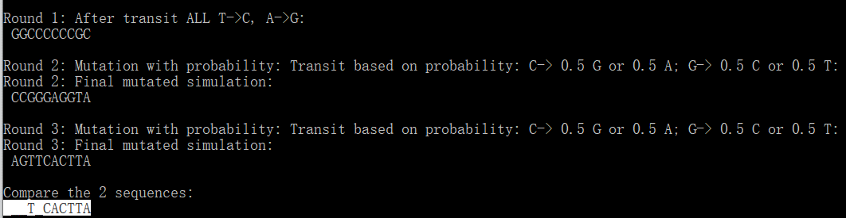
Difference

Slide 4
Deprecated
New .nex file
GBAC1_7_001 CACGACAAT…
GBAC1_7_002 GCTAGGCTA…
GBAC1_7_003 CTAGGTACG…
GBAC1_7_004 TAGATACGA…
GBAC1_7_005 GATCGATCG…
Simulated 4 seqs by probabilities
Original seq

Slide 5
New .nex file
Mutation
Rate (lambda)
Generation
GBAC_7_0.1151 TCTACGCTA …
GBAC_7_0.2351 GCTAGGCTA…
GBAC_7_0.1887 CTAGGTACG…
GBAC_7_0.2804 TAGATACGA…
Original_seque GATCGATCG…
Simulated 4 seqs by probabilities
Original seq
- Out put should all be the same number of generations .. GCAT is fine;
GCAT_7_XXXXXXX ... where X is the mutation rate at each generation;
mutation rate: You set that in your script; it can have many rates for each generation.

Slide 6
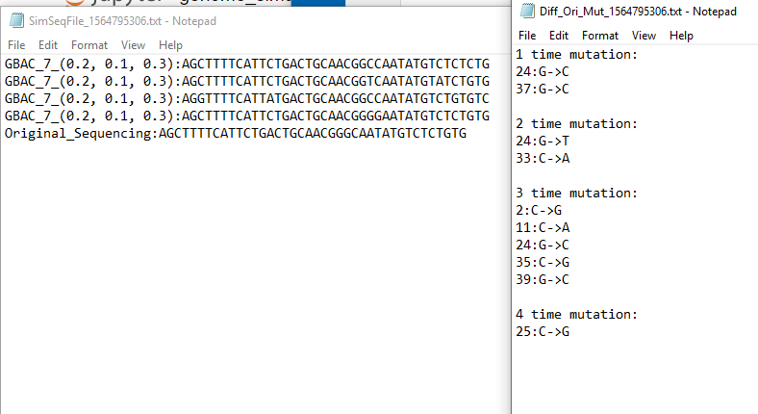
Check the difference_08022019
File1:
Mutated sequences:
File2:
Difference: index+change
.txt
Origin:
0:
1:
2:
3:
4:
TCTACGCTA
T

Slide 7
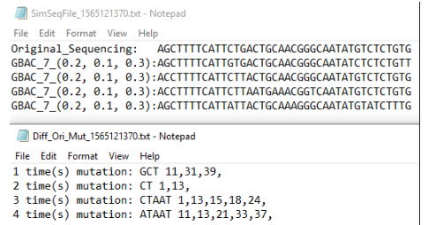
Check the difference_08062019
Output file 1:
original;
Mutated simulation for N times.
Output file 2:
Mutated bases
Index(position) mutated
Sub-list
index

Slide 8
Clustering
Assuming you have N sequences. You will have to create N x N matrix where each element (cell) will contain the distance between the corresponding sequences. The value of this distance can be calculated by aligning sequences against each other and calculating alignment score or using some other score. Also, it will be a symmetric matrix i.e. distance between seqA and seqB will be same as distance between seqB and seqA. so you only need to compute half of the matrix.
Once you are done with the matrix creation, you can proceed to Hierarchical clustering.
You will have to start with sequences that have the smallest distance between them. You will merge them and will have to come up with a way to create a consensus sequence that represent the two sequences. Then you will have to create the distance matrix again and merge the two sequences with the smallest distance. This will go on until you are finished with the sequences.

Slide 9
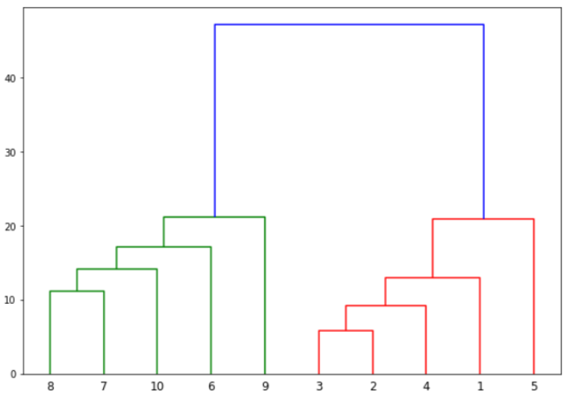
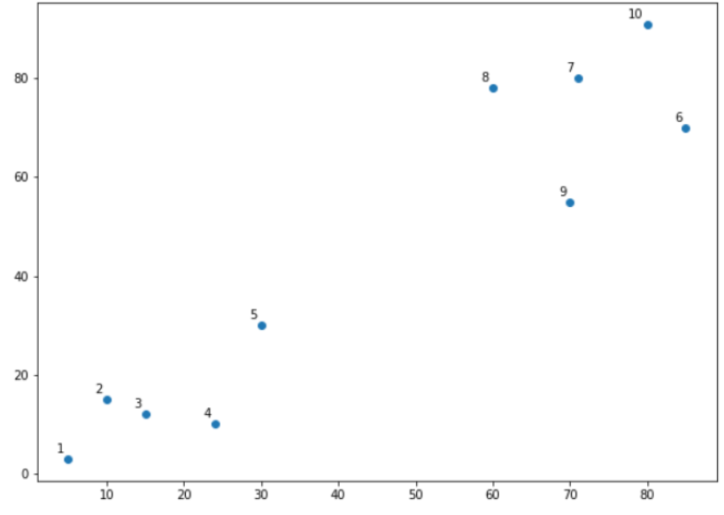
Dendrogram
2 and 3 are closest to each other while points 7 and 8 are closes to each other. Therefore a cluster will be formed between these two points first.
1. Euclidean distance basis;
2. vertical height of the dendogram :
the Euclidean distances between points.

Slide 10
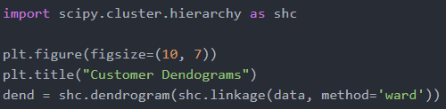
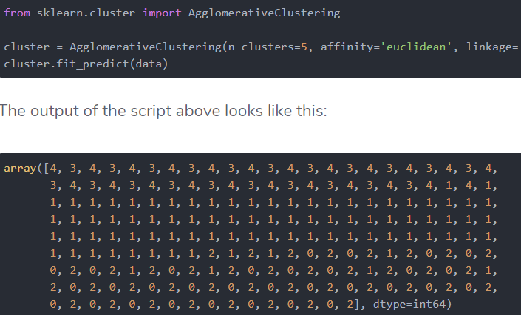
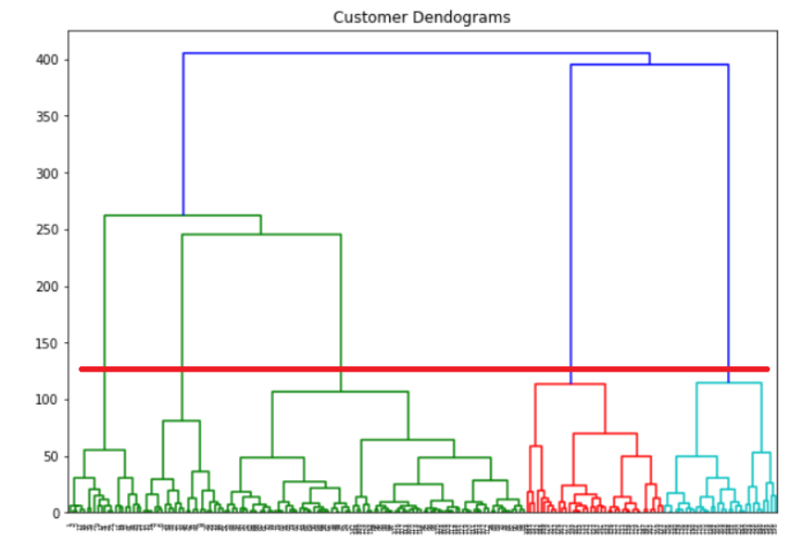
Dendrogram-e.g.:
Step 2:
the next step is to group the data points into these five clusters.
To do so we will again use the AgglomerativeClustering class of the sklearn.cluster library.
Step 1:
We know the number of clusters
for our dataset,

Slide 11
Flexible method to cluster

Slide 12
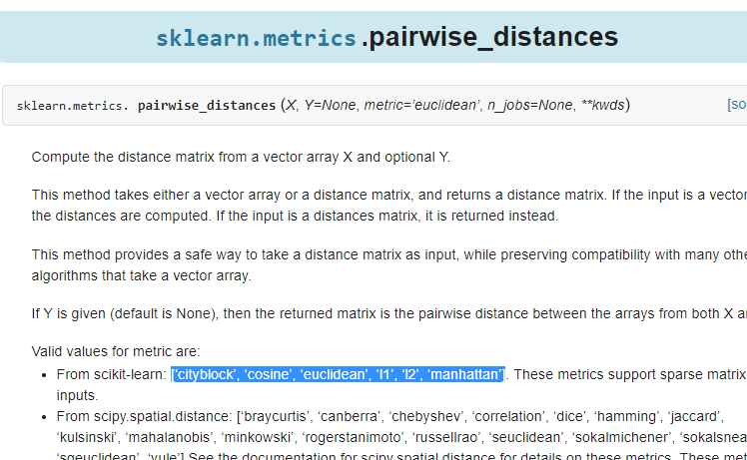
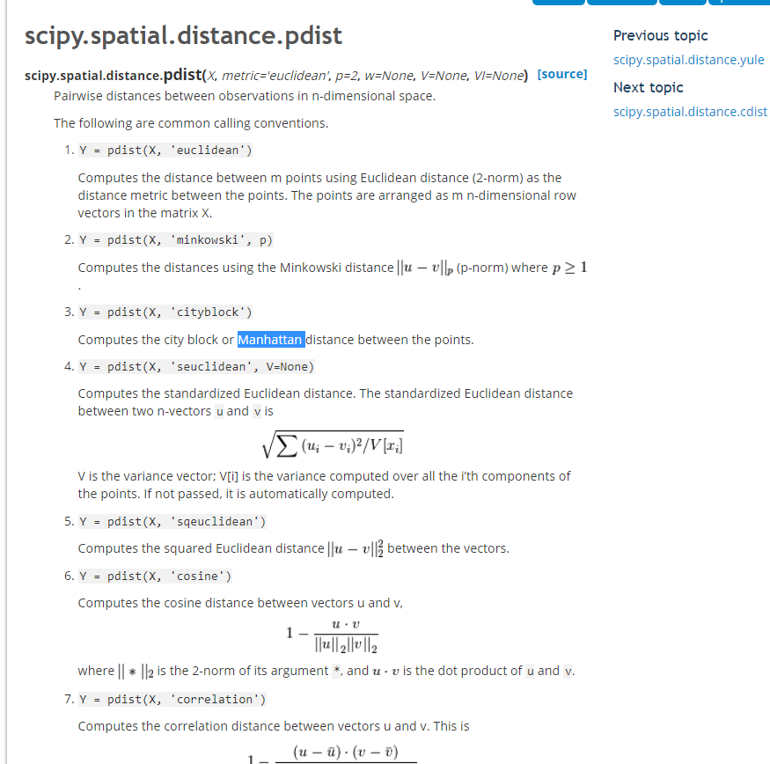

Slide 13
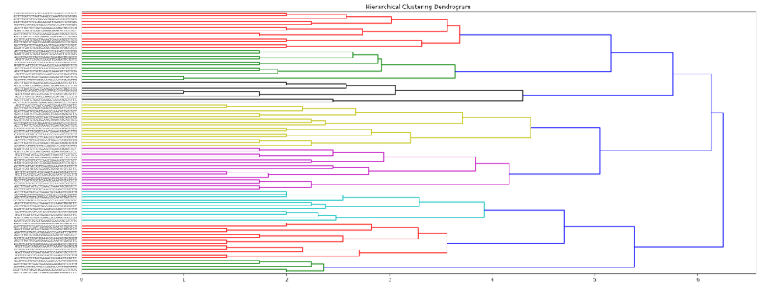

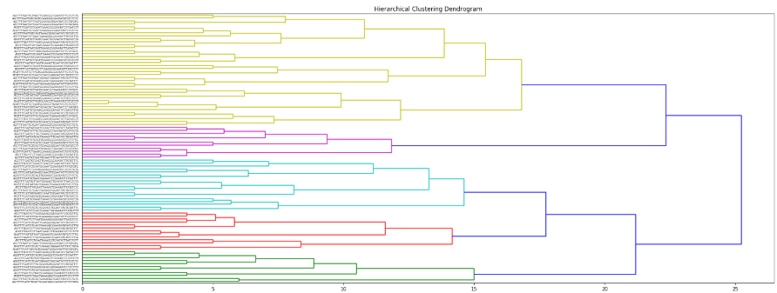

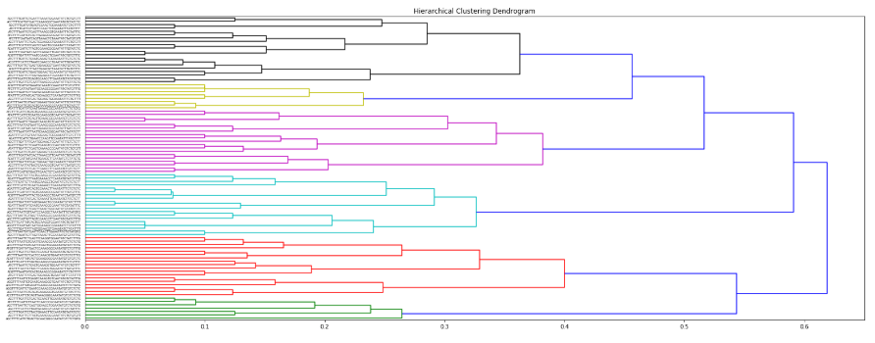

Euclidean
Ward +
Cityblock( Mahanttan)
Hamming

Slide 14
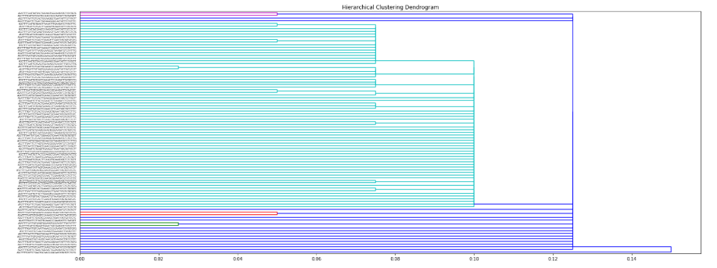

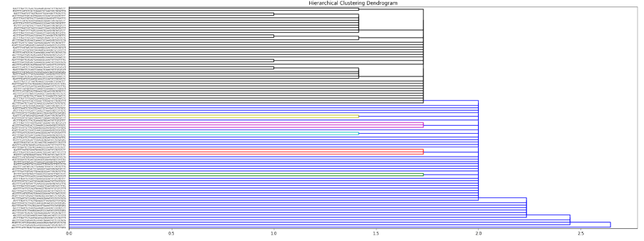

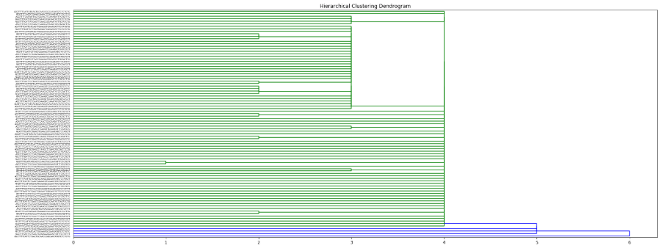

Euclidean
single+
Cityblock( Mahanttan)
Slightly better than ‘ward’
Hamming

Slide 15
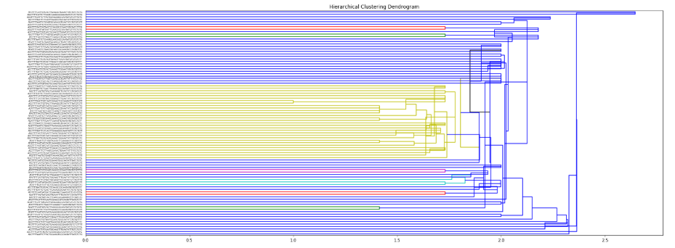

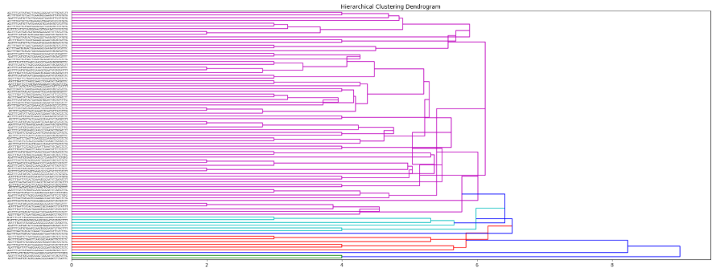

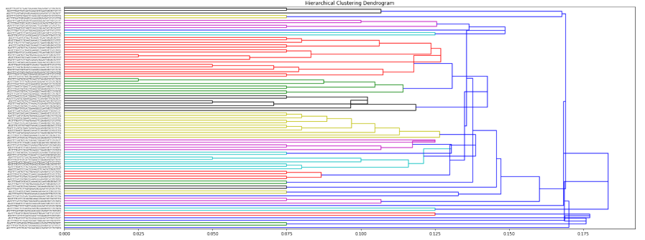

Euclidean
median+
Cityblock( Mahanttan)
Hamming

Slide 16
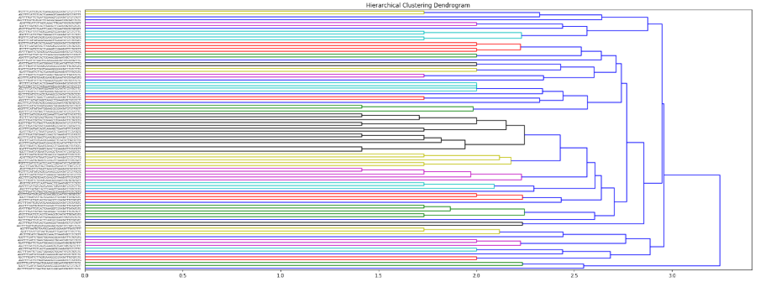

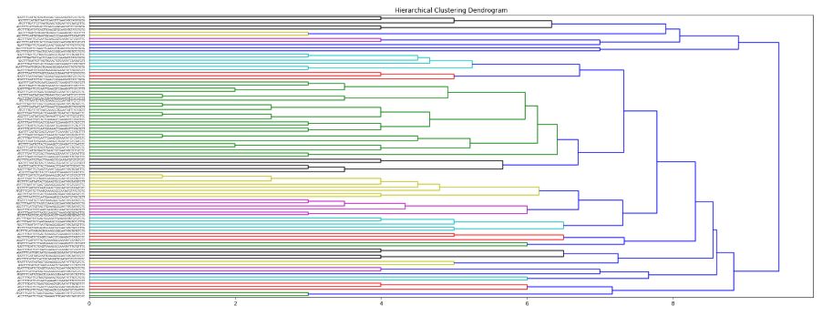

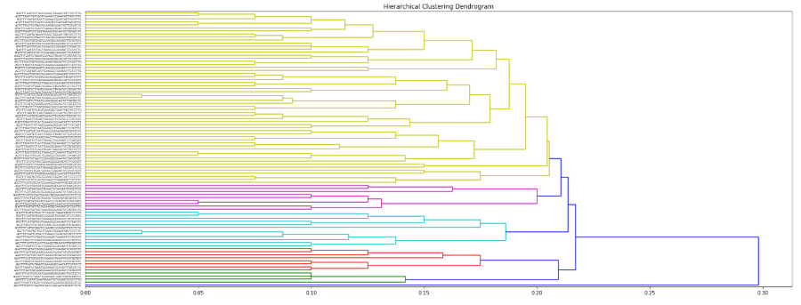

Euclidean (Best)
average+
Cityblock( Mahanttan)
Best
Hamming

Slide 17
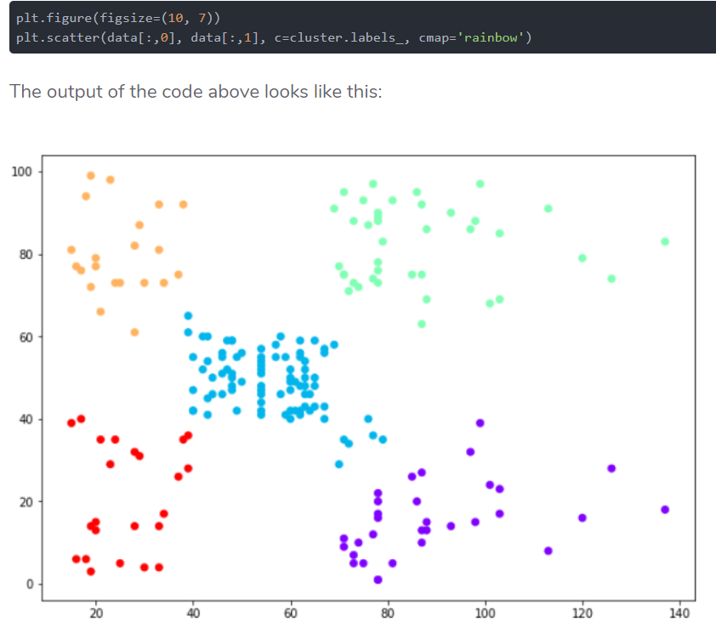
Dendrogram-e.g.2:
Step3: let's plot the clusters to see how actually our data has been clustered:

Slide 18
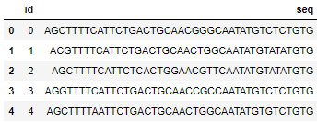
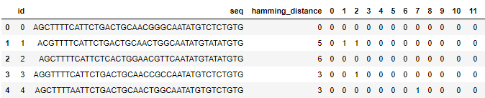
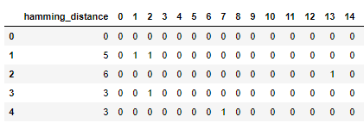
Process of my code:
Ori_seq
Mutation simulation
df_mutseq_hamming
Euclidean,
Minkowski,
Cityblock,
Cosine,
Correlation,
Hamming…
Hamming distance calculation
pdist( df_remove_seq , ‘hamming’)
linkage( pdist, 'ward')
Dendrogram
df_mutseq_hamming
’single’,
‘complete’,
‘average’,
‘centroid’,
‘ward’,
‘median’
Calculate
Cophenetic Correlation Coefficient to assess quality of clusters
cophenet(linked, df_remove_seq_pdist)
Predict
df_remove_seq
Hamming distance matrix

Slide 19
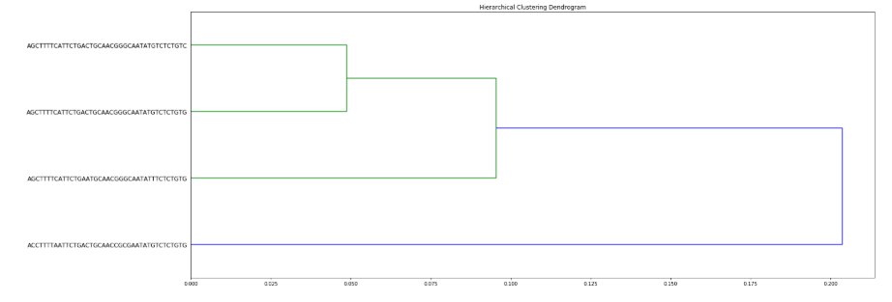
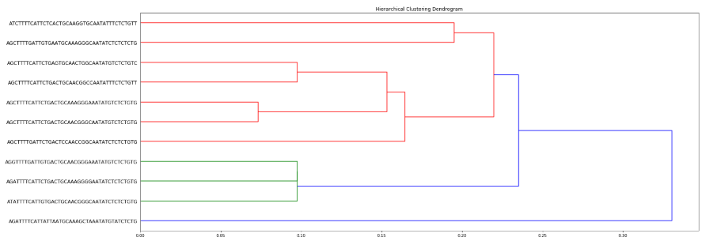
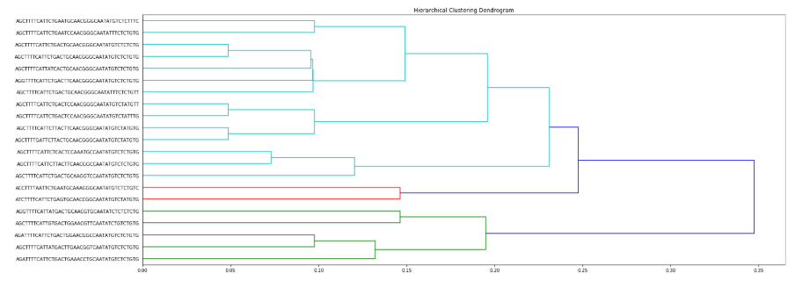
N = 3
Cophenet = 0.9543119
N = 10
Cophenet = 0.779745
N =20
Cophenet = 0.62685810

Slide 20
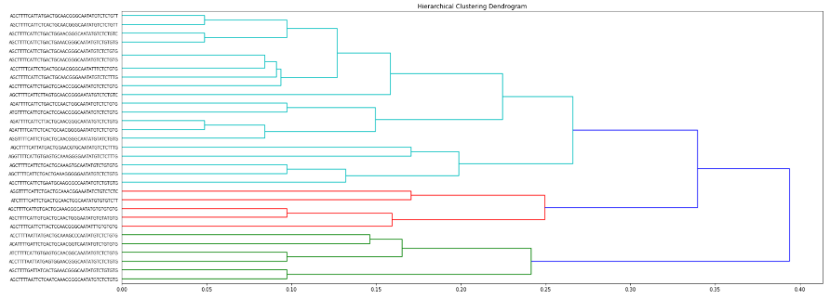
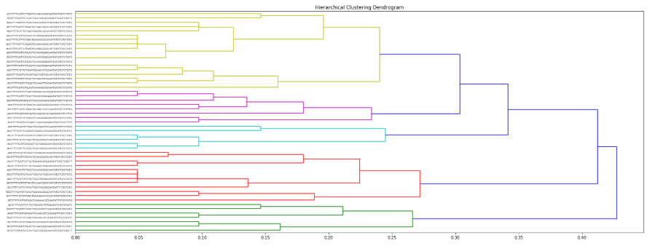
N = 30
Cophenet = 0.6485041
N = 50
Cophenet = 0.5297912

Slide 21
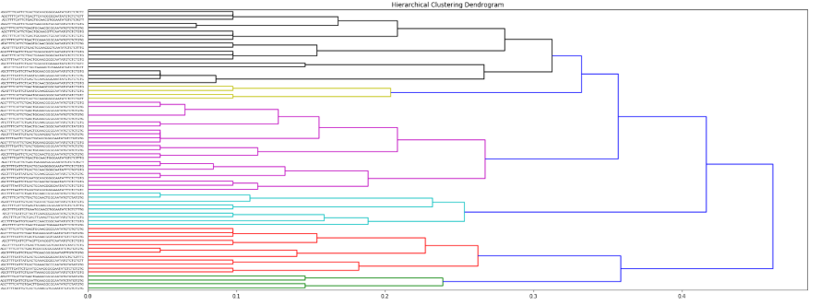
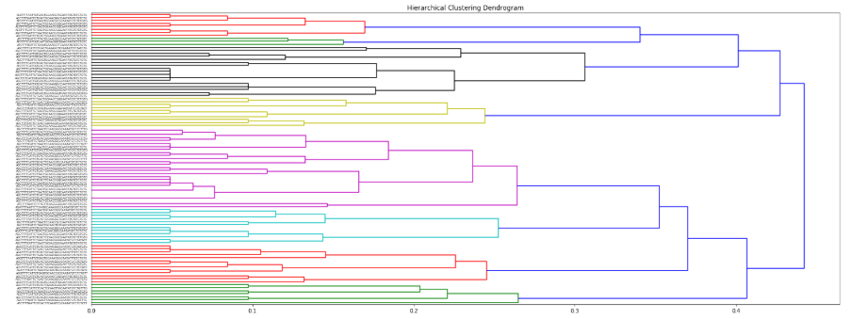
N = 70
Cophenet = 0.49547436
N = 96
Cophenet = 0.453248271

Slide 22
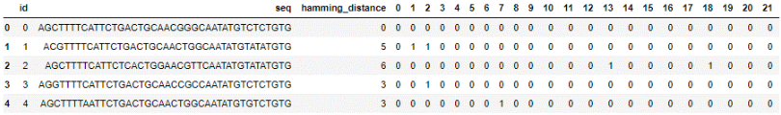
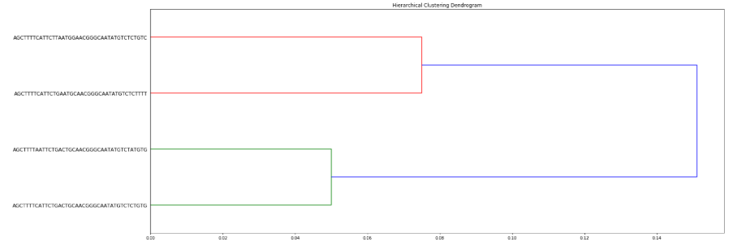
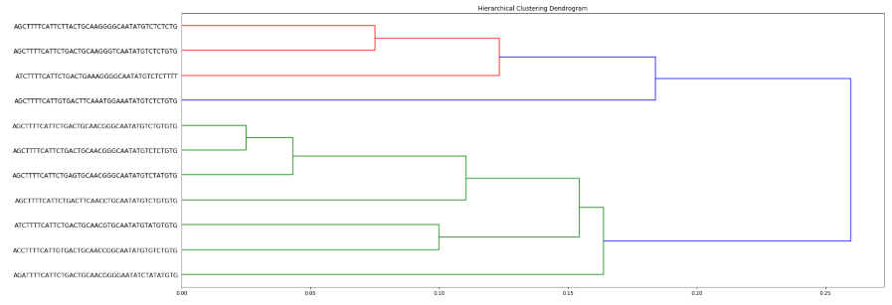
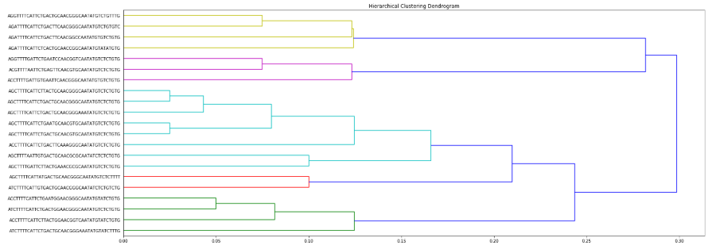
Remove this one
N = 3
Cophenet =0.72799109
N = 10
Cophenet =0.5992157
N = 20
Cophenet =0.6156744

Slide 23
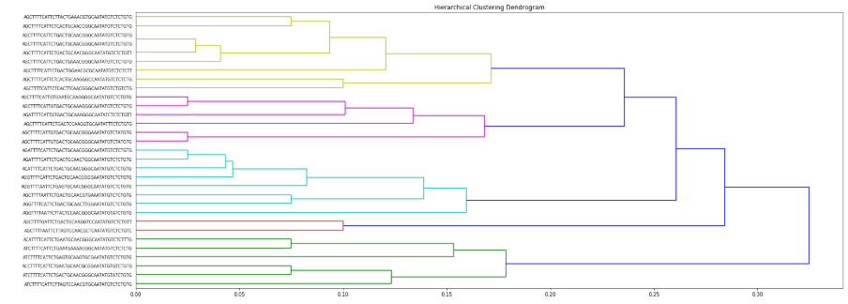
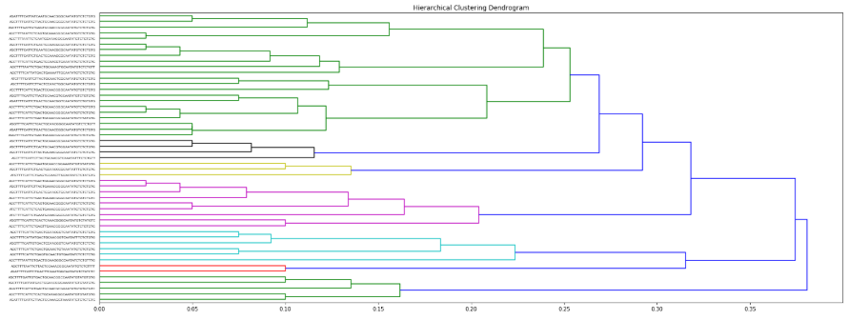
N = 30
Cophenet = 0.6485041
N = 50
Cophenet = 0.499737865

Slide 24
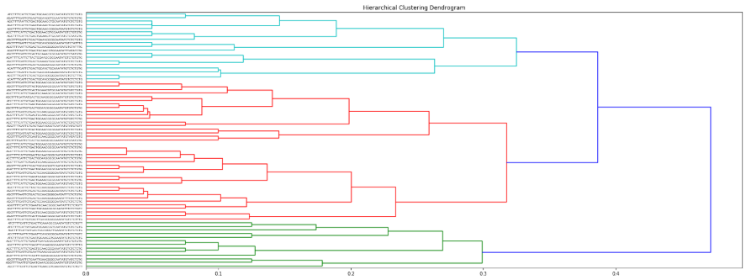
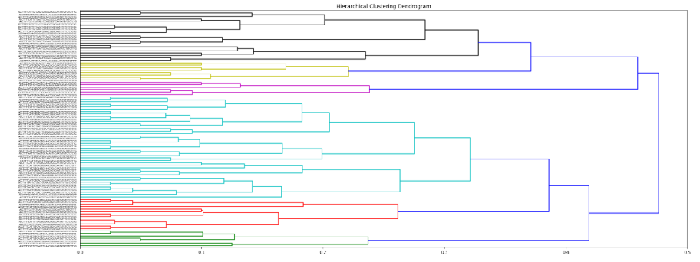
N = 70
Cophenet = 0.550373048
N = 96
Cophenet = 0.41278386

Slide 25
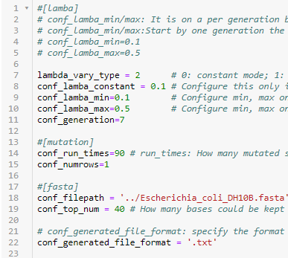
Varying lambda
0: constant
1: random
2: min/max

Slide 26
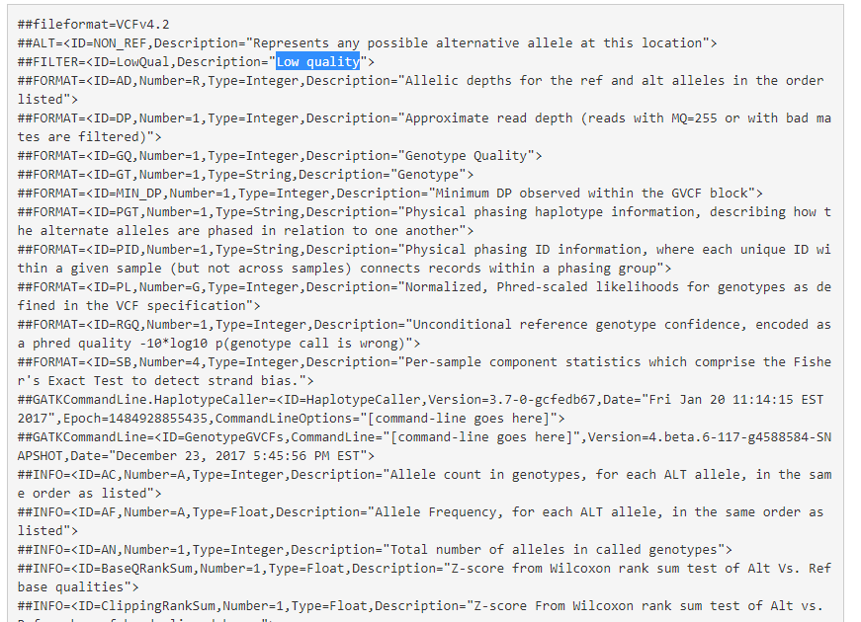
VCF
?? Mean by ‘low quality’ in filter.

Slide 27
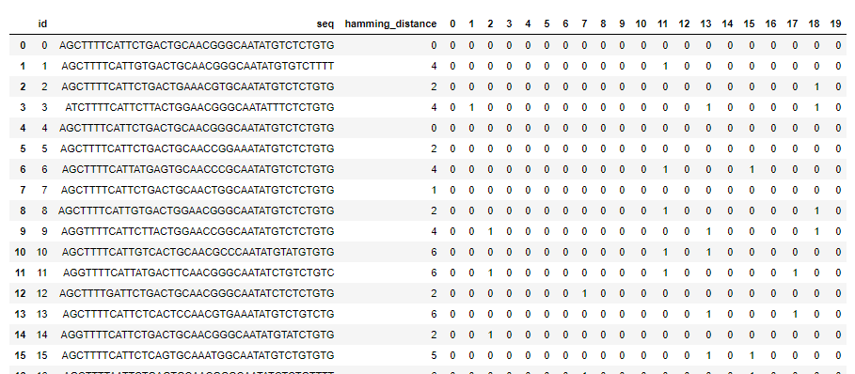

Slide 28
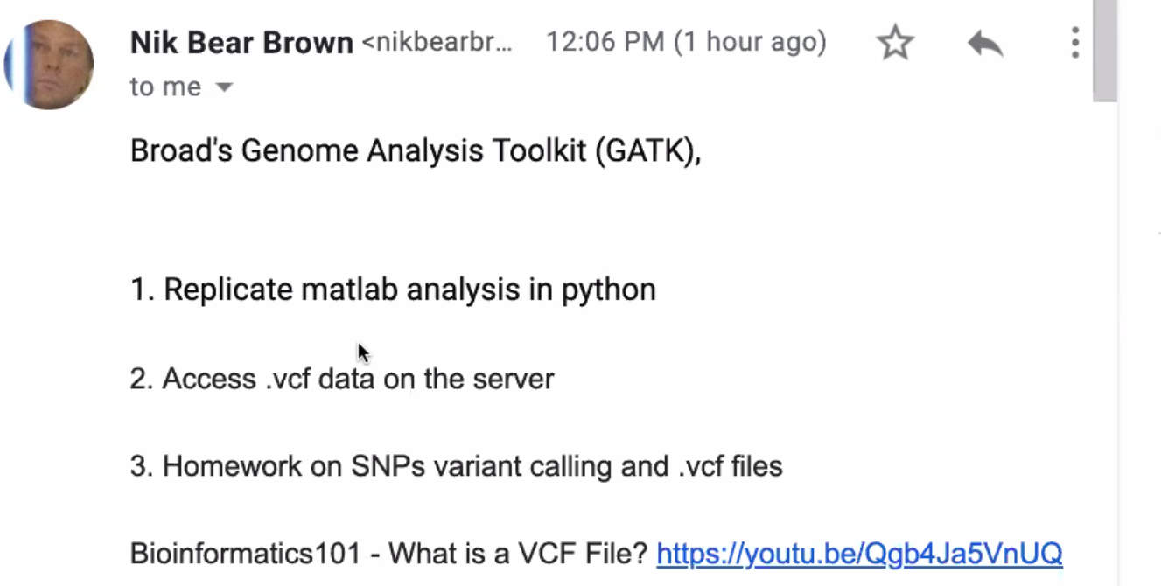
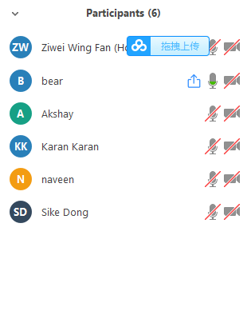
8.16 meeting:

